Slide 1
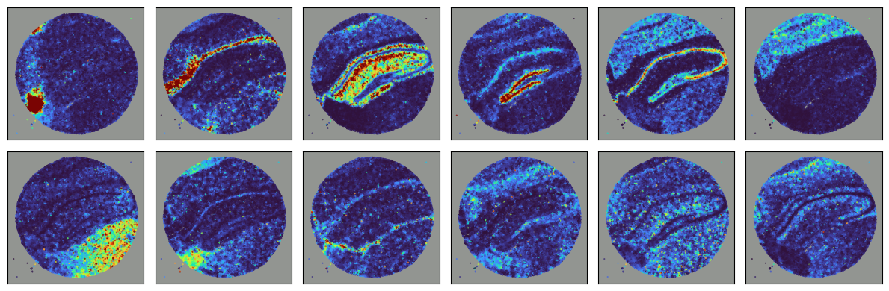
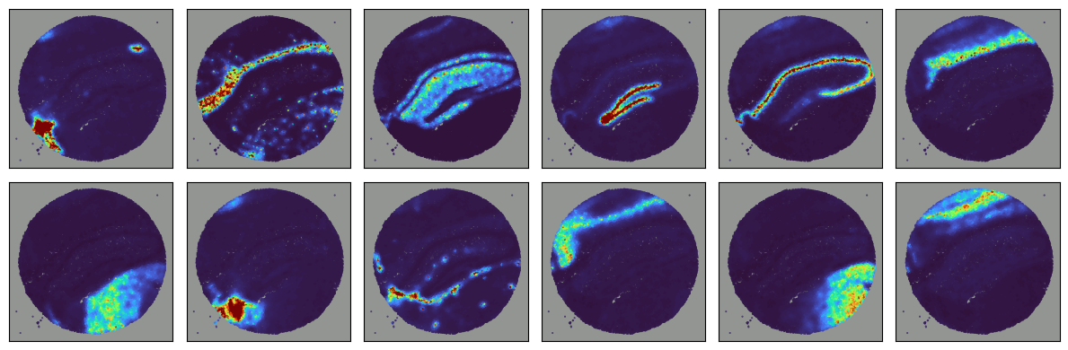
NMF Initialized Factors
Converged Spatial Factors
SVI
Training

Slide 2
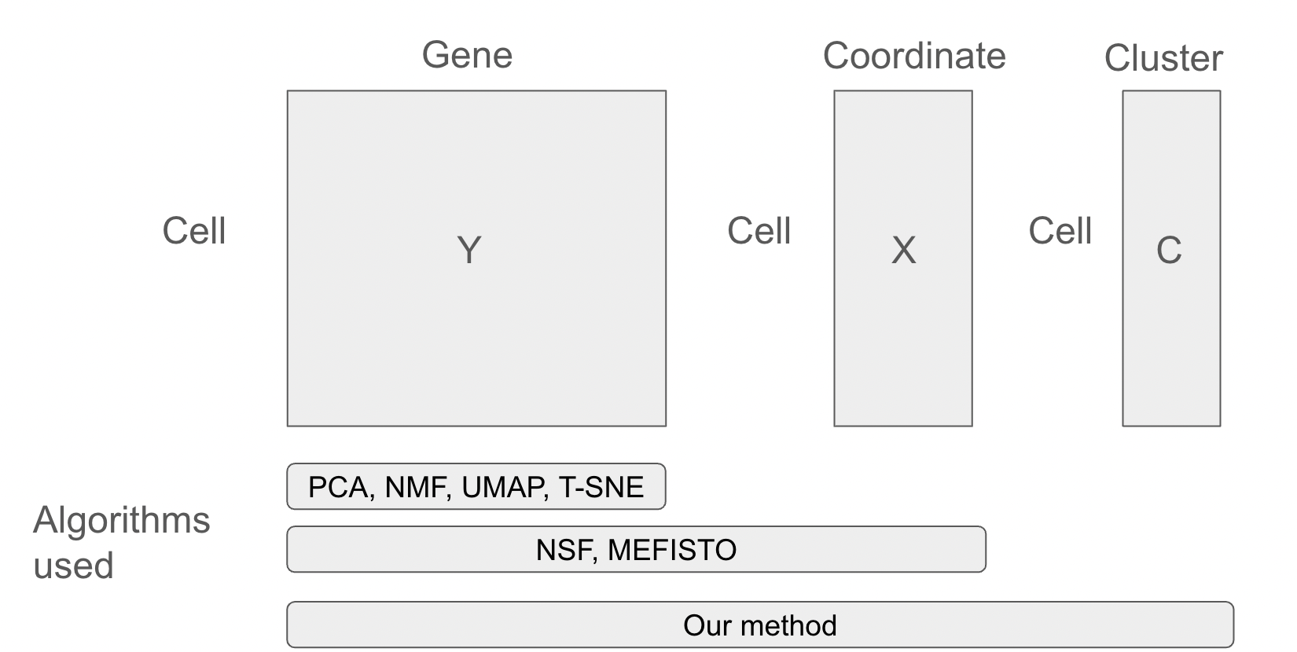
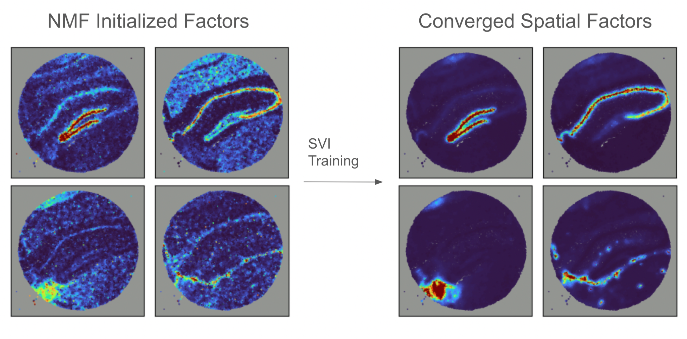
a)
b)

Slide 3
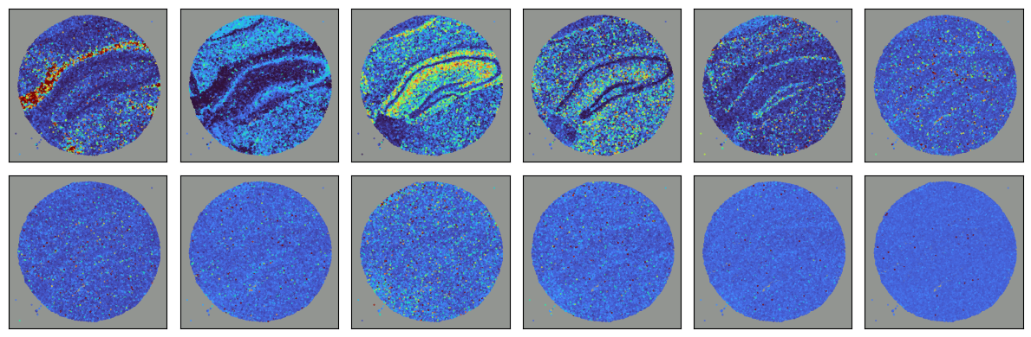

Slide 4
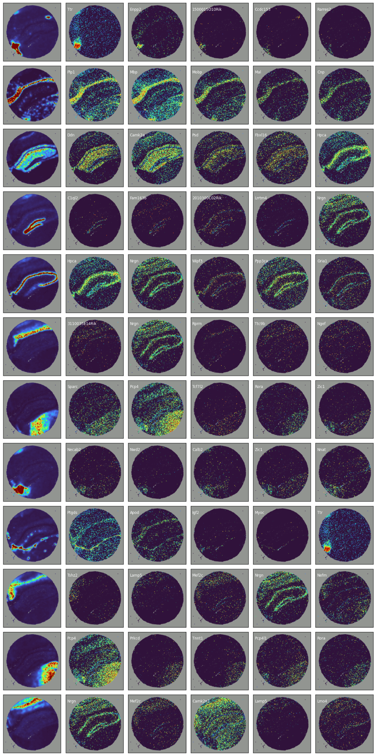

Slide 5
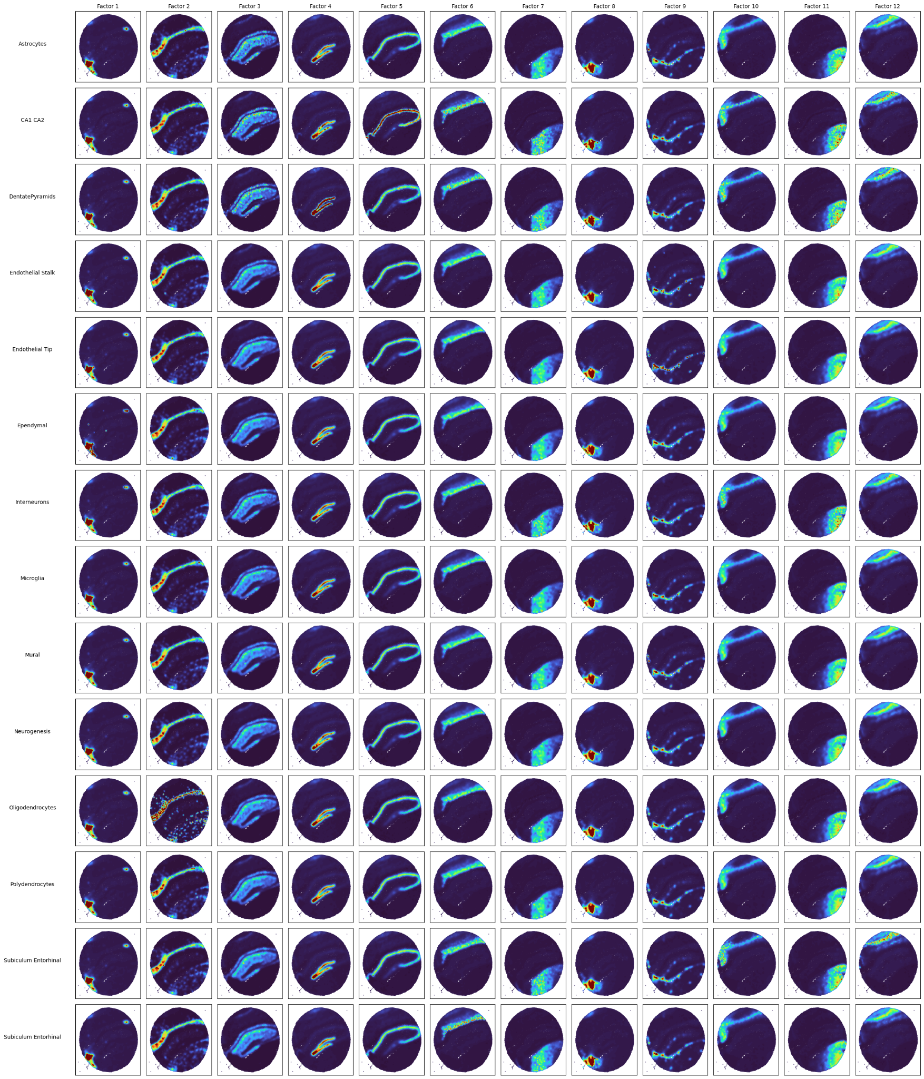

Slide 6
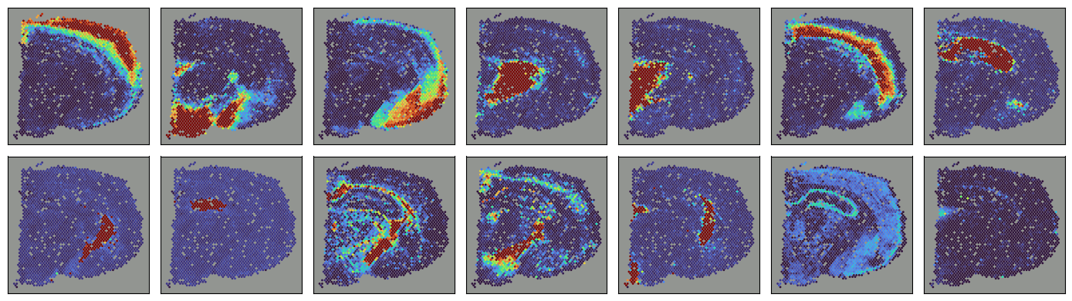
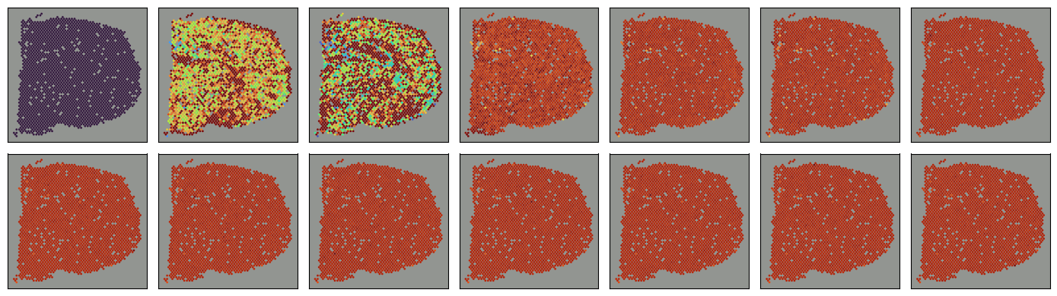

Slide 7
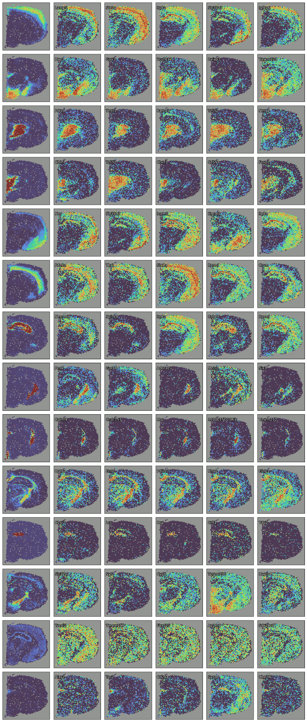

Slide 8
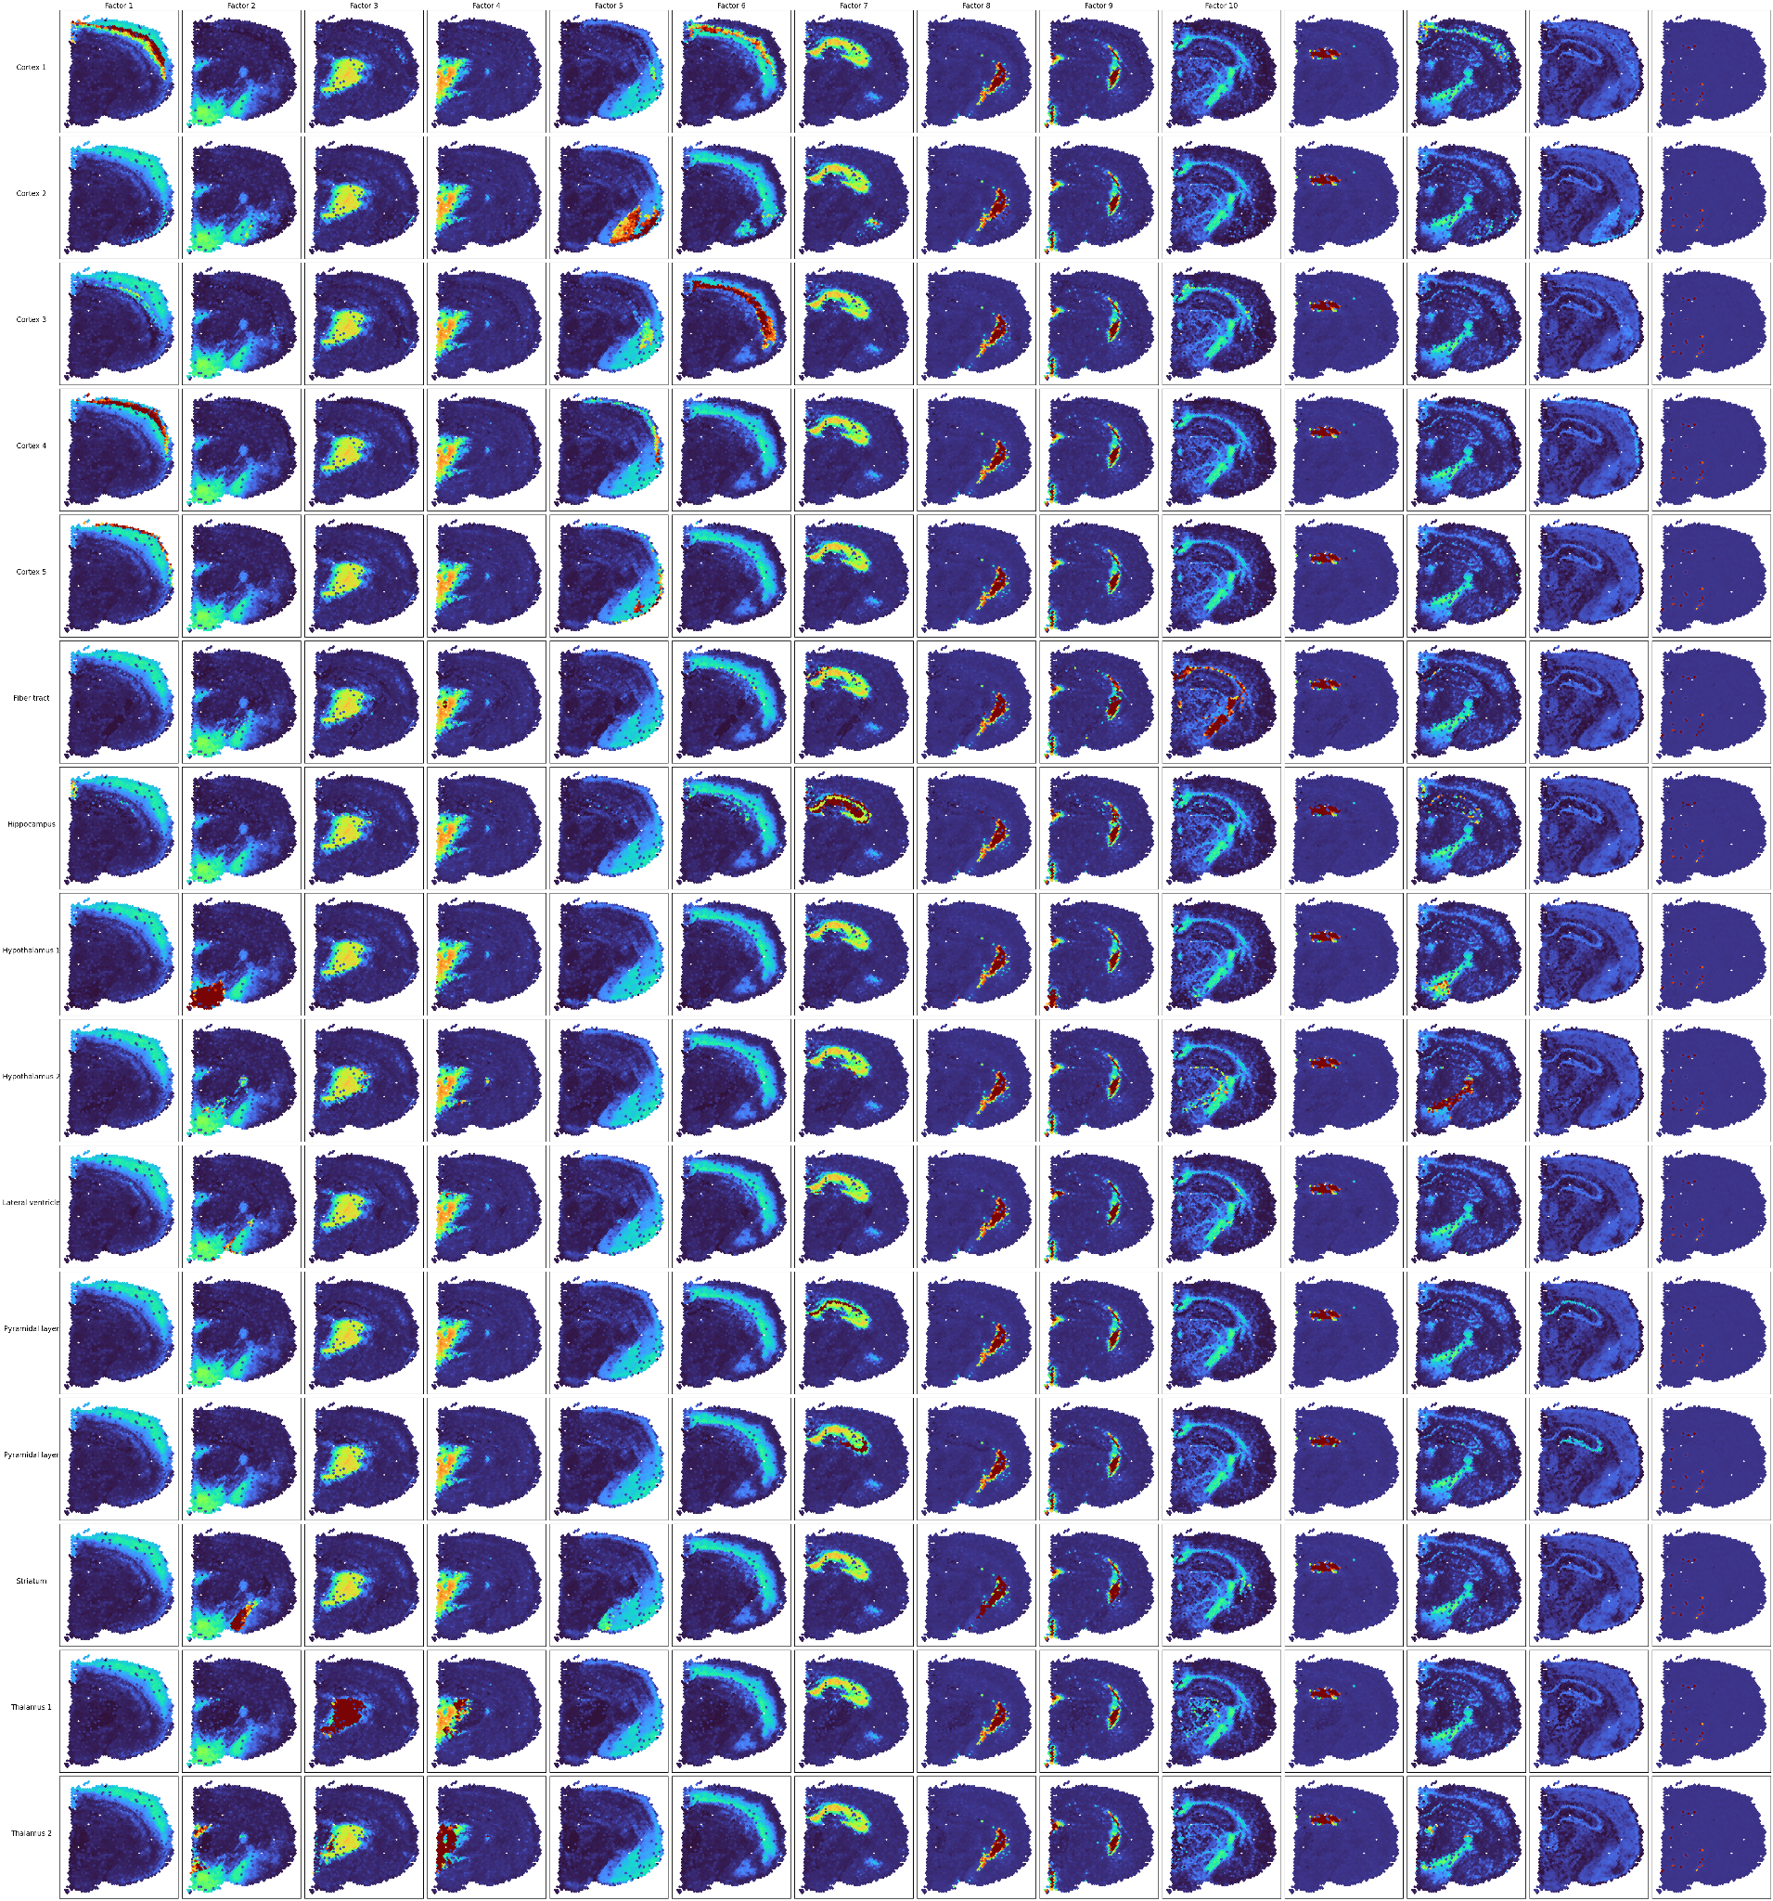

Slide 9
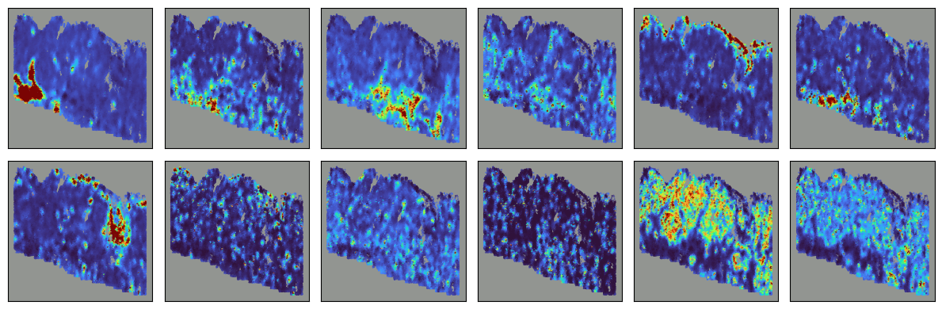
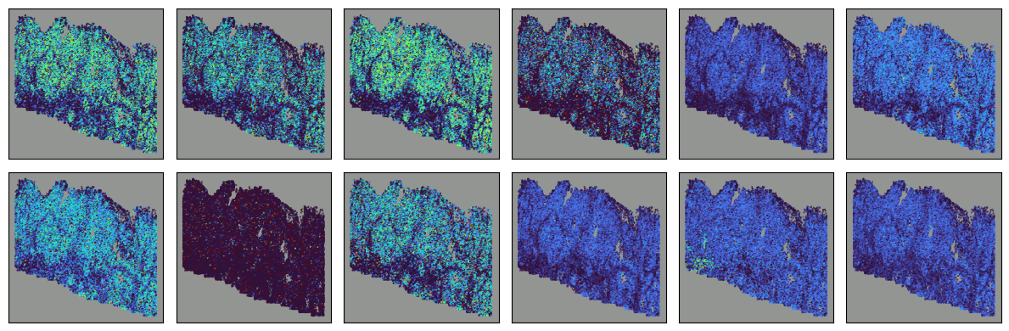

Slide 10
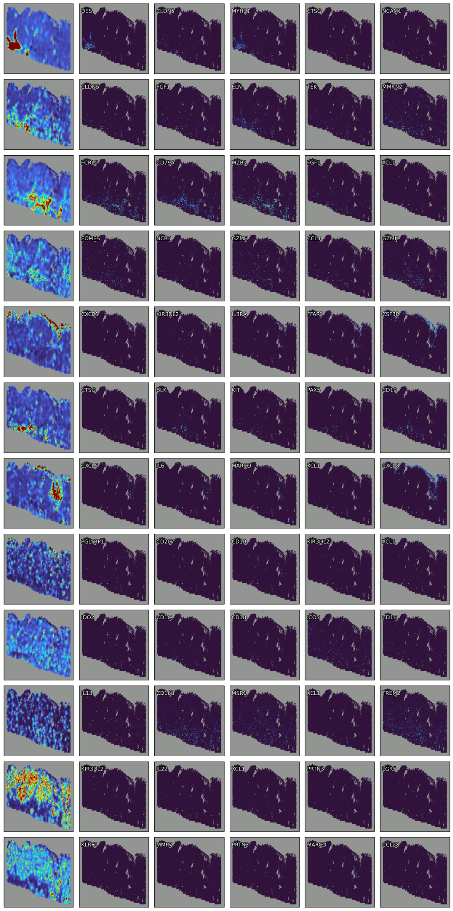

Slide 11
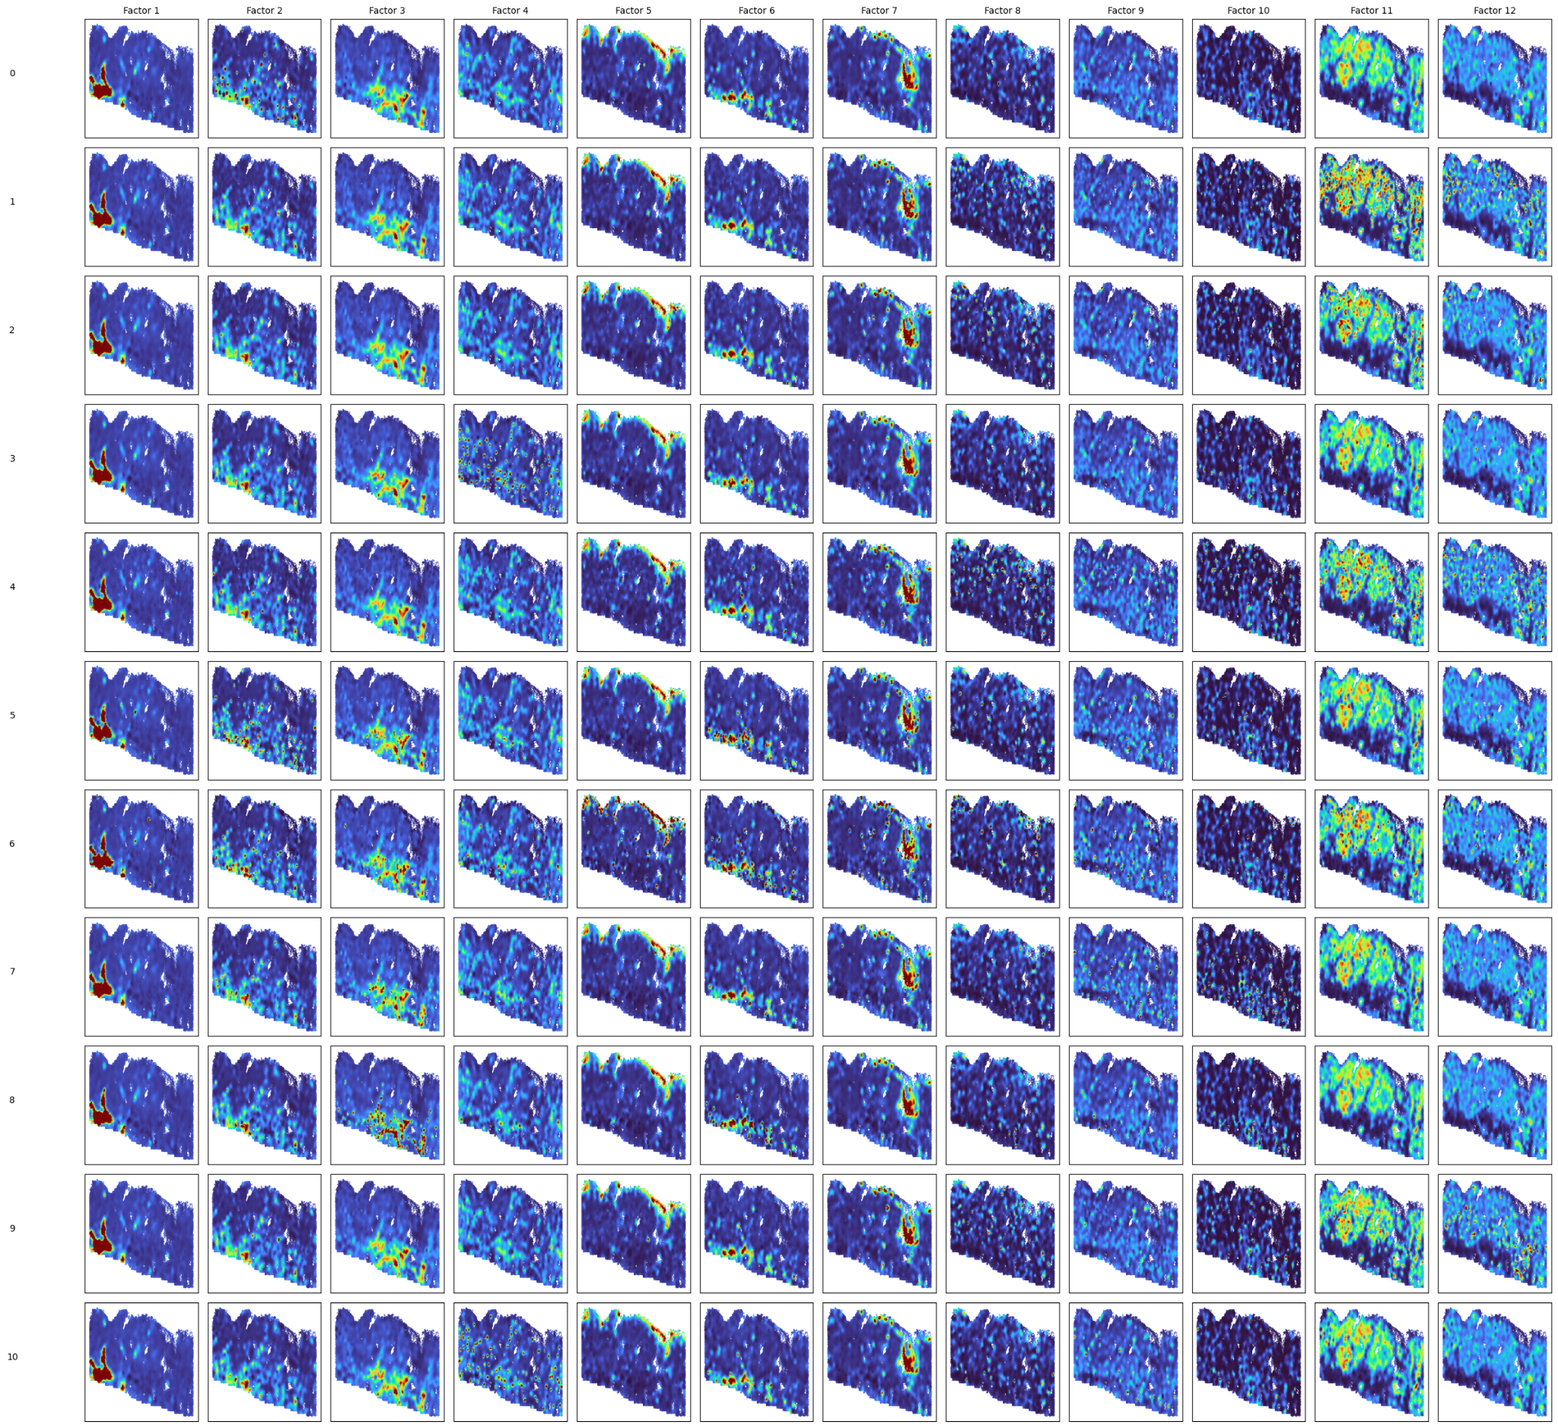

Slide 12
Components
Gene
Gene
Components
W
Cell
≈
Cell
F
Y
Factors
Loadings

Slide 13
Data format
Gene
Coordinate
Cluster
Cell
Cell
Cell
Y
X
C
PCA, NMF, UMAP, T-SNE
Algorithms
used
NSF, MEFISTO
Our method

